Slide 1
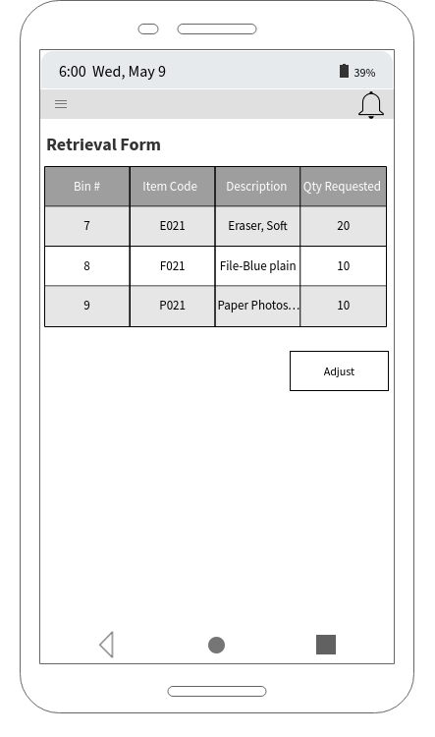
Example of Mobile Screen of Inventory Retrieval
This would be how the mobile version of the inventory retrieval form would look like. There would be an adjust button at the bottom which would redirect the user to the adjustment voucher screen to make an adjustment if needed.

Slide 2
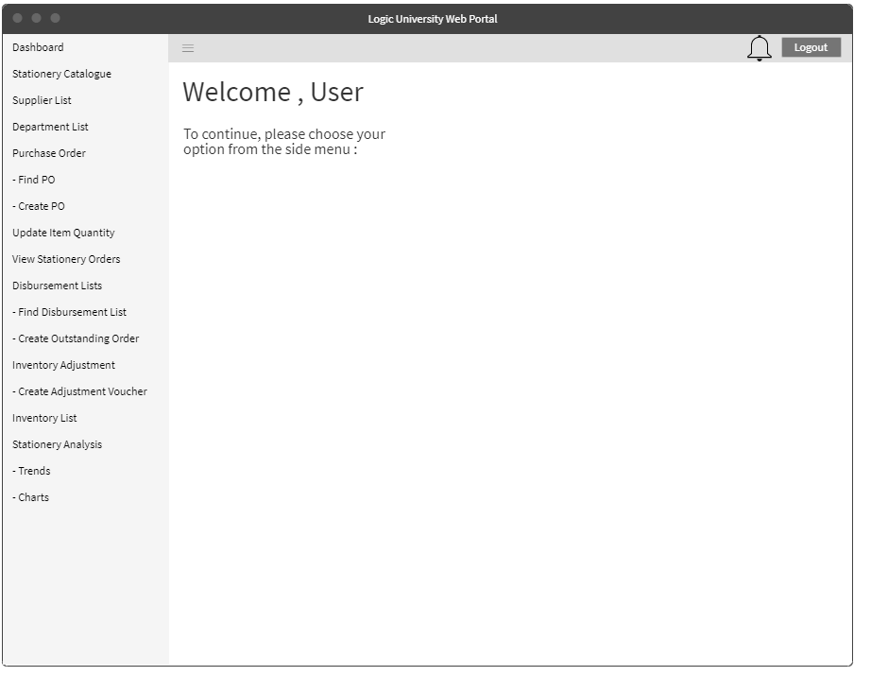
Home Page
Once user is login, he will be lead to the homepage, where user will be able to click the menu bar and view list of menu on the side.

Slide 3
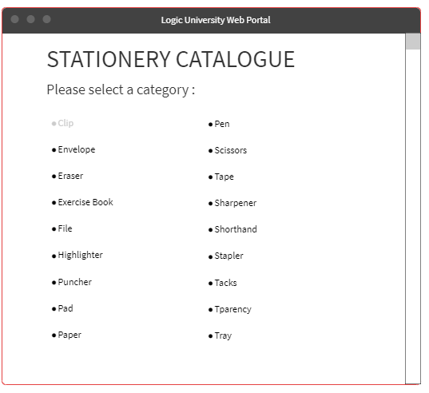
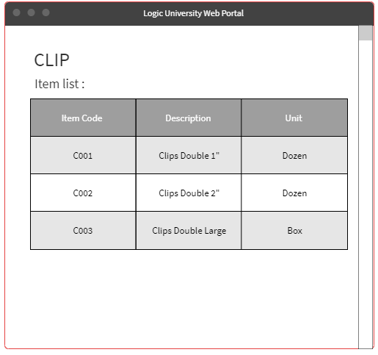
Stationery Catalogue For Department

Slide 4
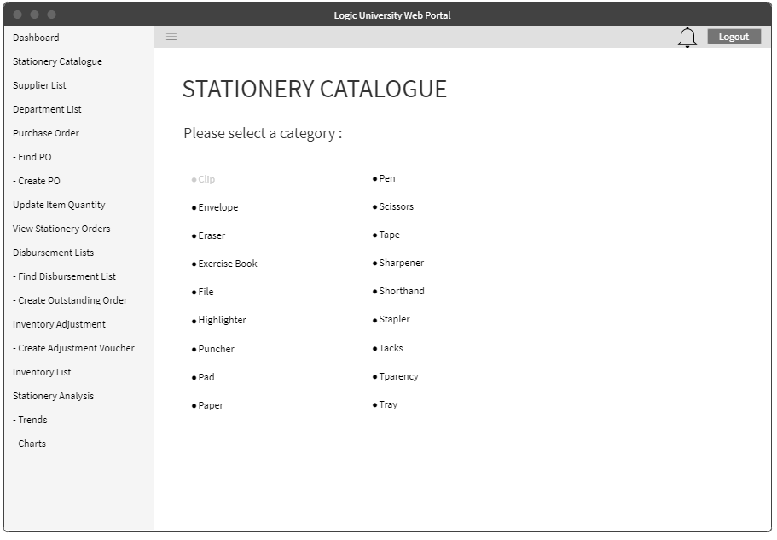
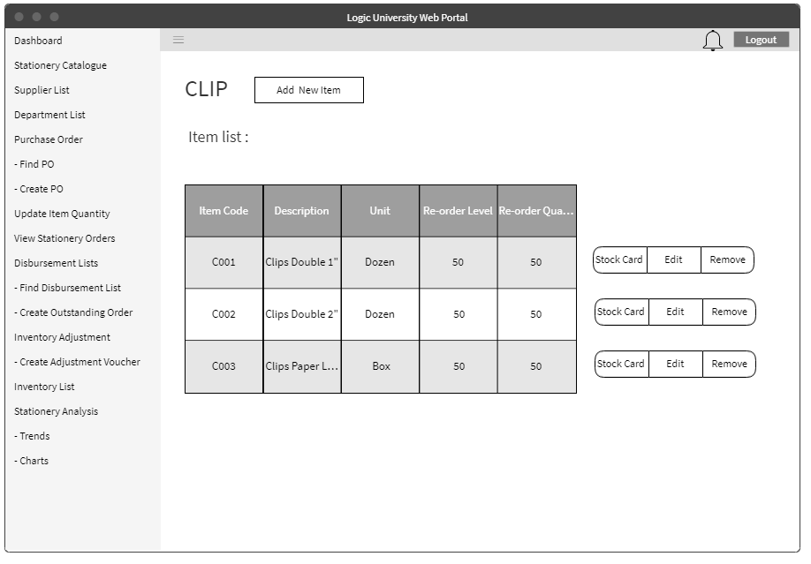
Stationery Catalogue For Store

Slide 5
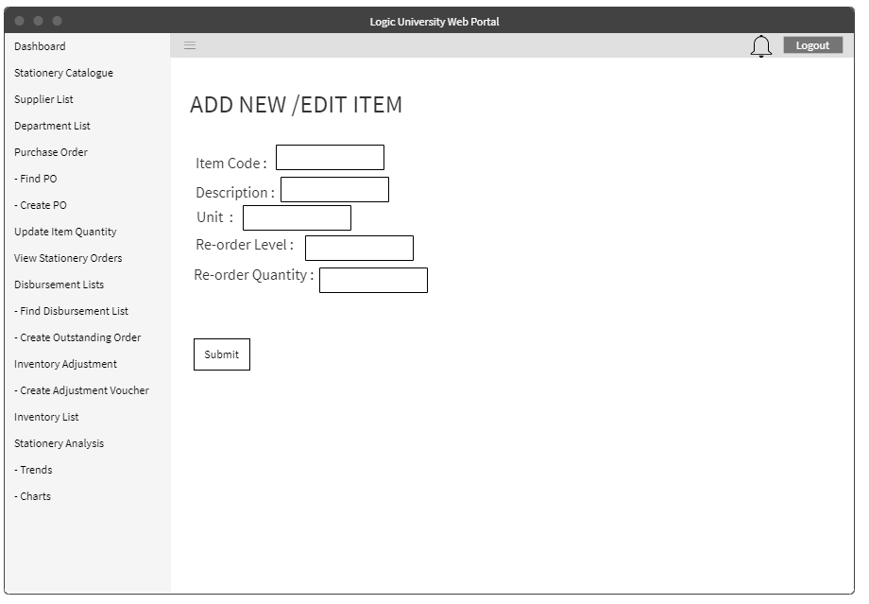
Stationery Catalogue For Store
Store clerk will be able to refer to the stationery catalogue and make an edit for that particular item.

Slide 6
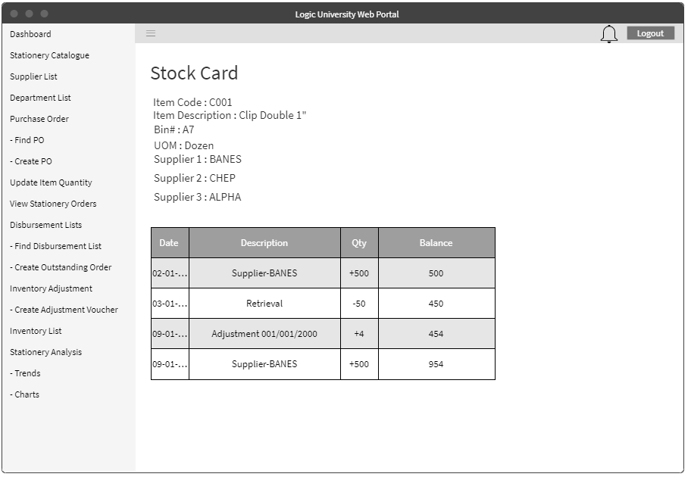
Stock Card
In addition, each item will have its own stock card and accessible via the stationery catalogue.

Slide 7
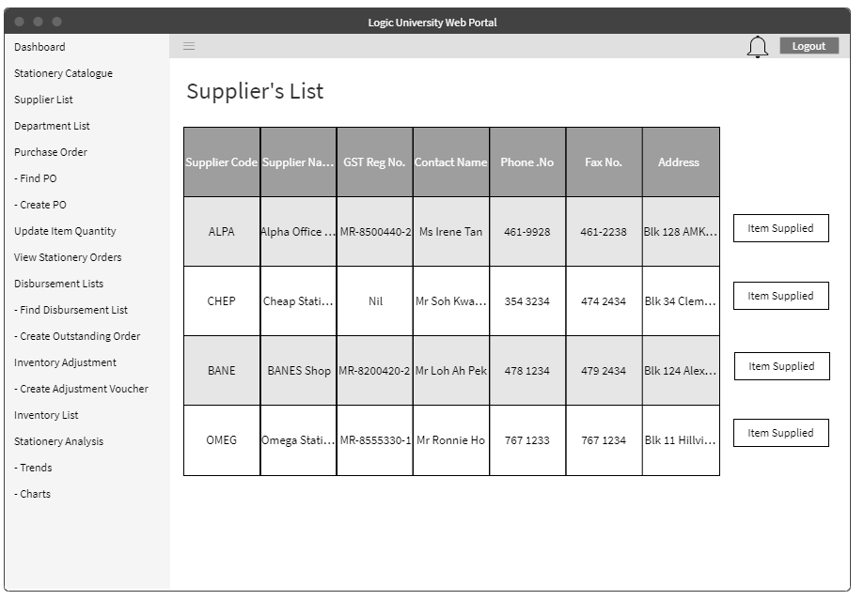
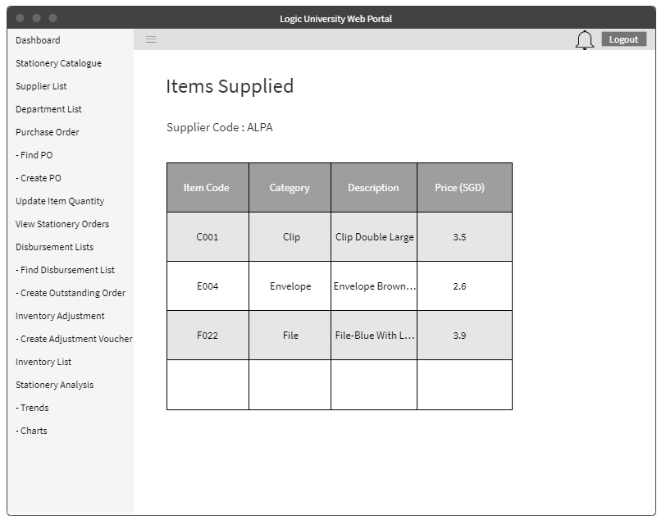
Supplier List for Store Clerk and Store Supervisor
Store Clerk and Store Supervisor will be able to check supplier’s list and the items supplied by that supplier.

Slide 8
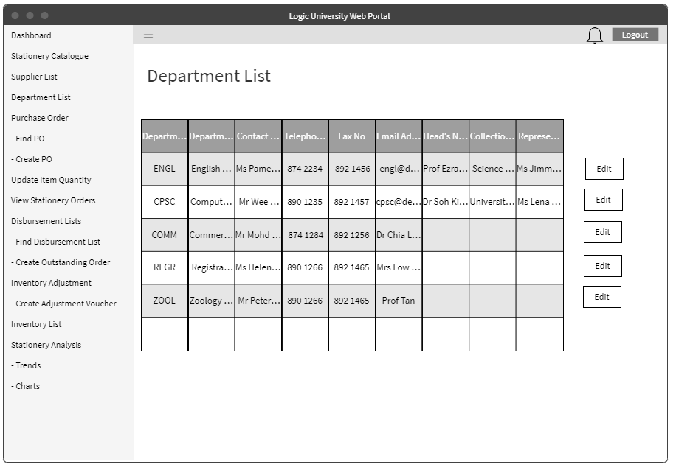
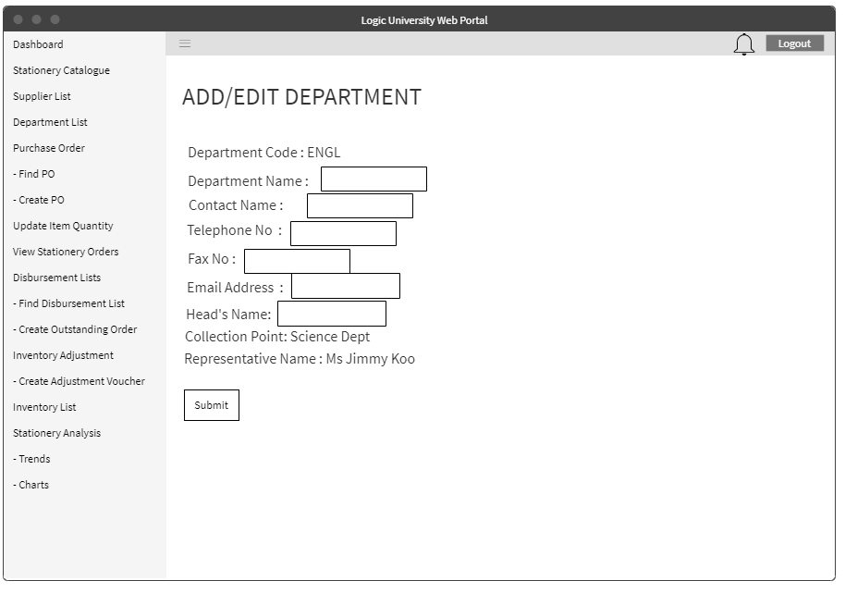
Department List for Store Clerk
For Store Clerk, he will be able to see the department list and modify some details for that particular department.

Slide 9
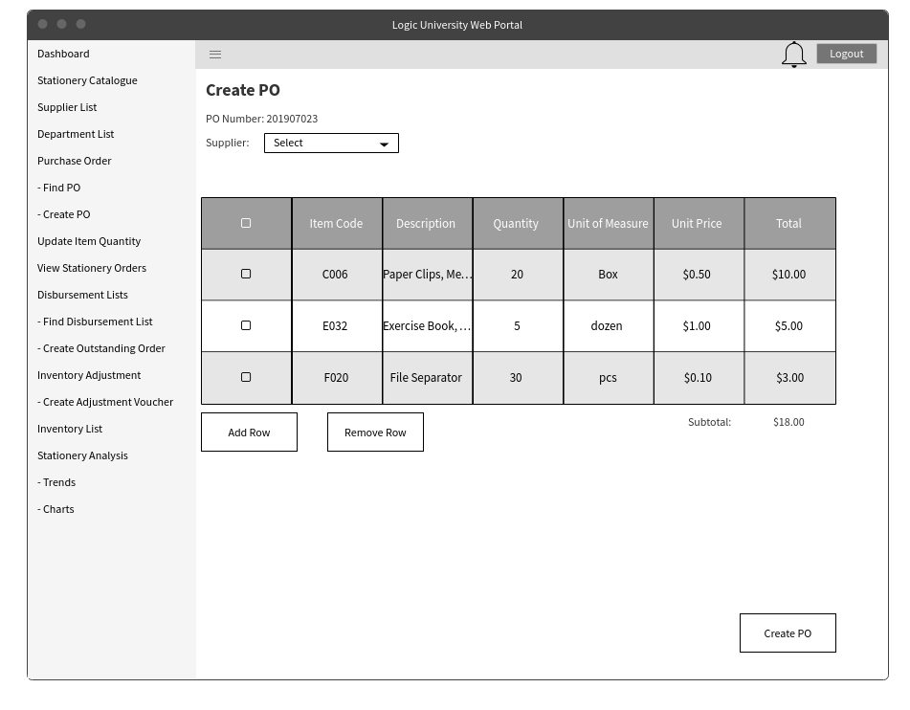
Create Purchase Order
This would be the screen for creating a purchase order. The user would be able to choose the supplier and also the inventory that would be purchased from that supplier.Upon clicking the Create PO, it would be sent to the supervisor or manager for approval.

Slide 10
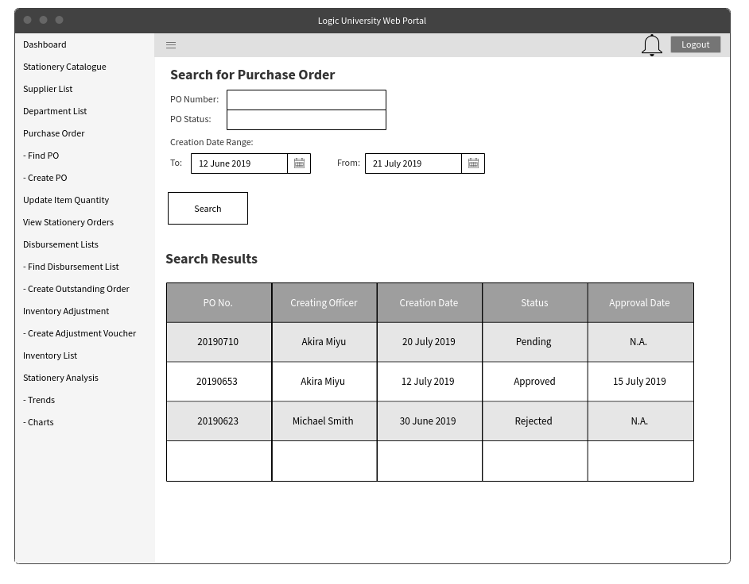
Purchase Order List
Viewing of the whole purchase order list can be done here. The option to filter the purchase order by either number, status or dates is also available.

Slide 11
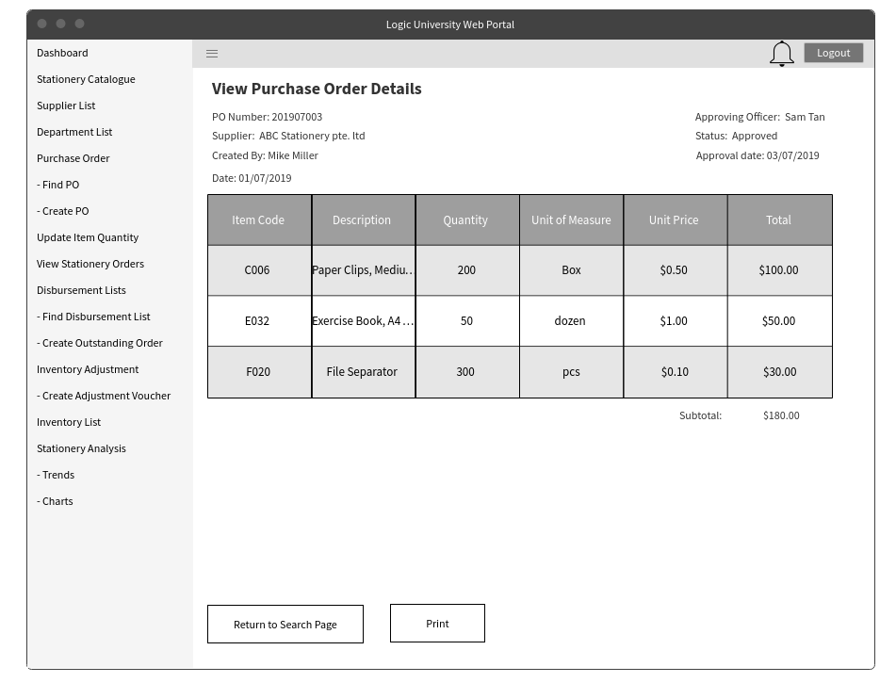
View Purchase Order Details
After searching for a particular PO, the detailed view would be shown. It would consist of the item details, price, quantity and the total price of the PO.

Slide 12
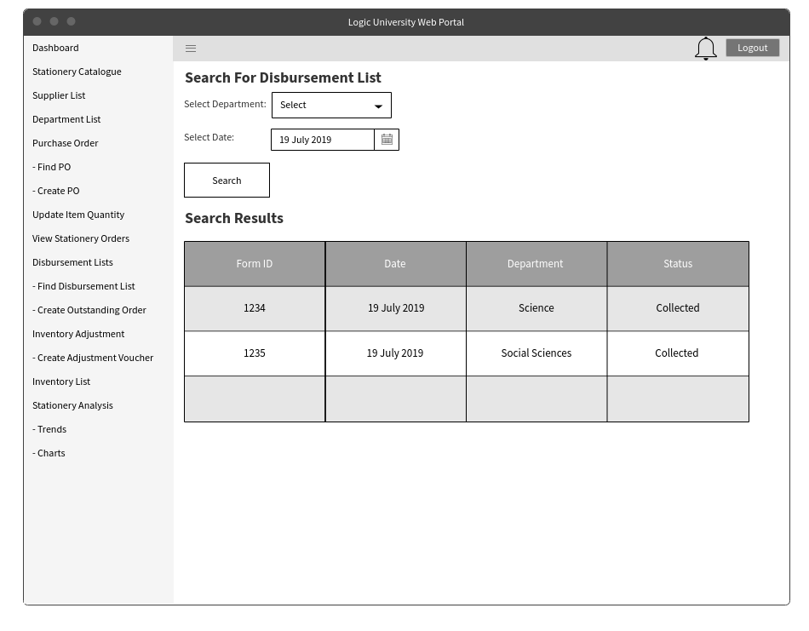
List of Disbursement List
Viewing of all disbursement lists can be done here. The option to filter the purchase order by either department or dates is also available.

Slide 13
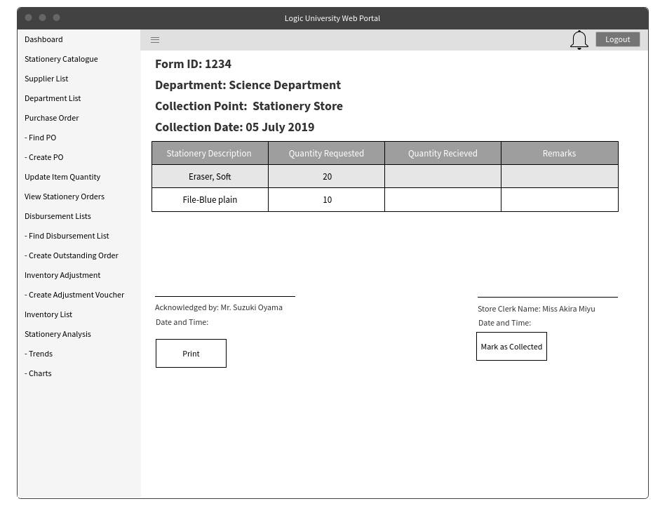
Detailed Disbursement List
After searching for a particular Disbursement List, the detailed view would be shown. It would consist of the item details, quantity received and quantity collected.

Slide 14
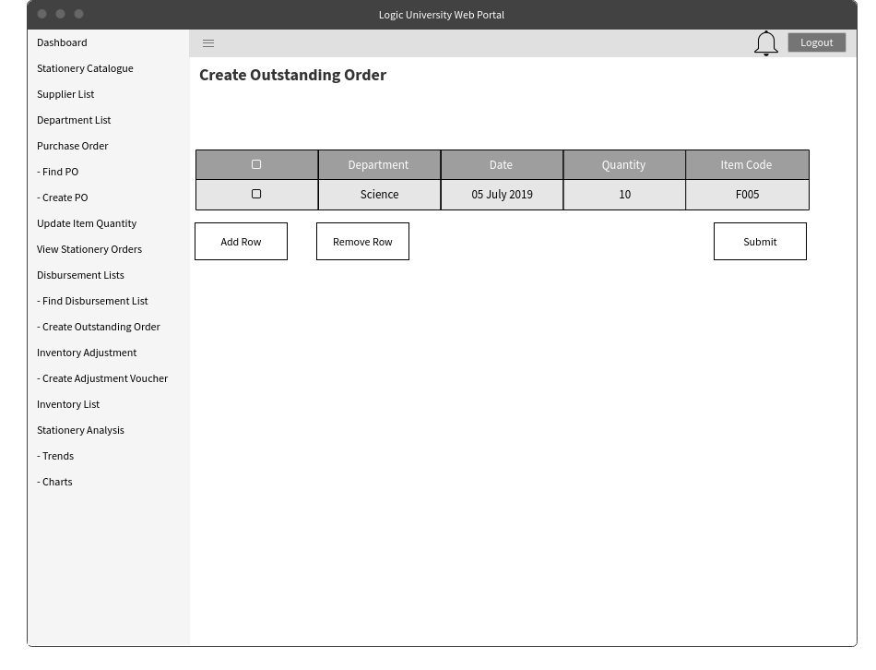
Create Outstanding Order
This would be the screen for creating a outstanding order. This would be used in scenarios where the orders are not fulfilled. The user would be able to choose the department and also the item and the quantity owed.

Slide 15
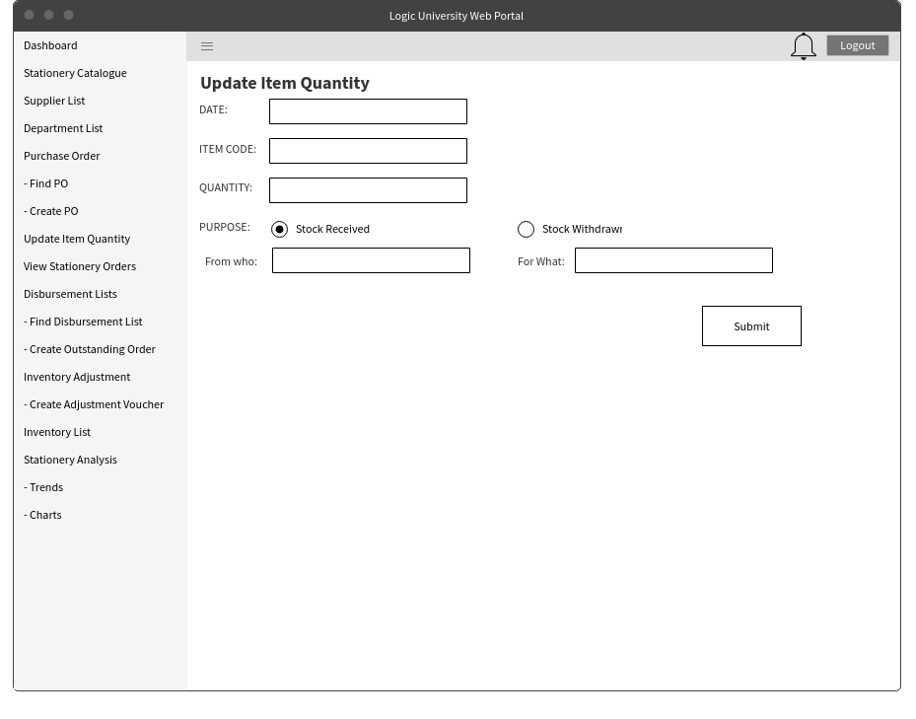
Update Item Quantity
This would be the screen for updating item quantity. This would be used in scenarios where items arrive from the supplier or removed from the warehouse. The user would be able to input the date, item code quantity and also whether it was stock received or withdrawn.

Slide 16
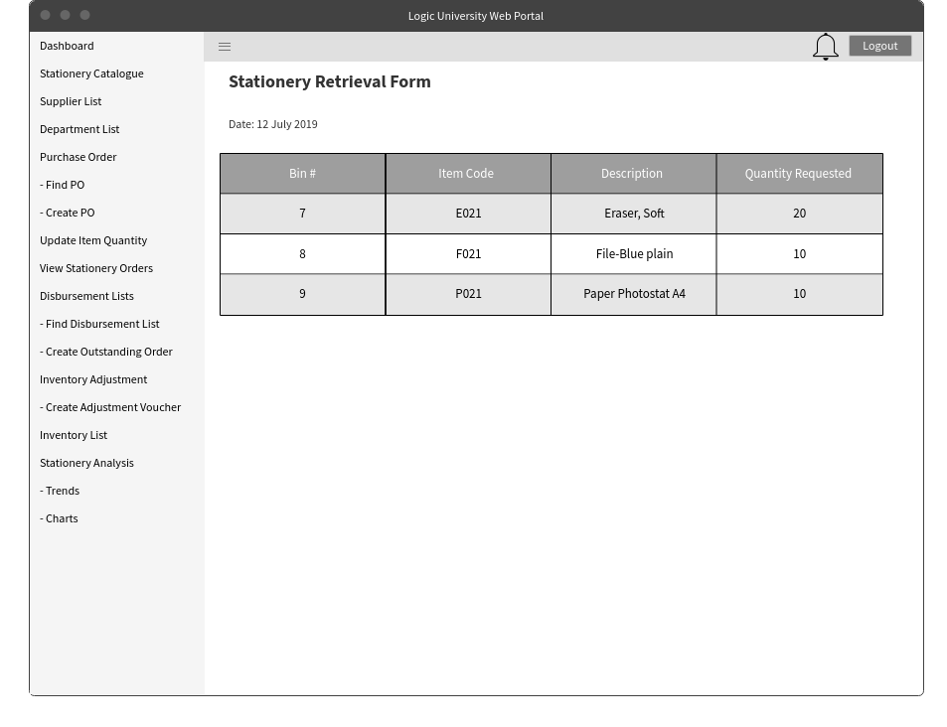
Inventory Retrieval Form
Viewing of all the items that need to be withdrawn from the warehouse based on all the requisition forms submitted. The user would be able to view the item details, its location and the requested quantity.

Slide 17
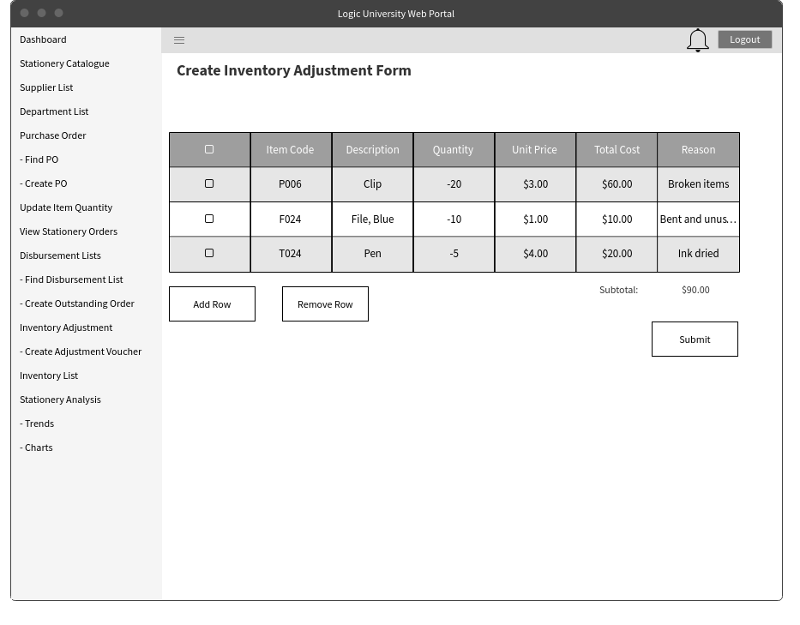
Create Inventory Adjustment Voucher
The adjustment of the inventory is done here. Adding row would create a next row to input the item.

Slide 18
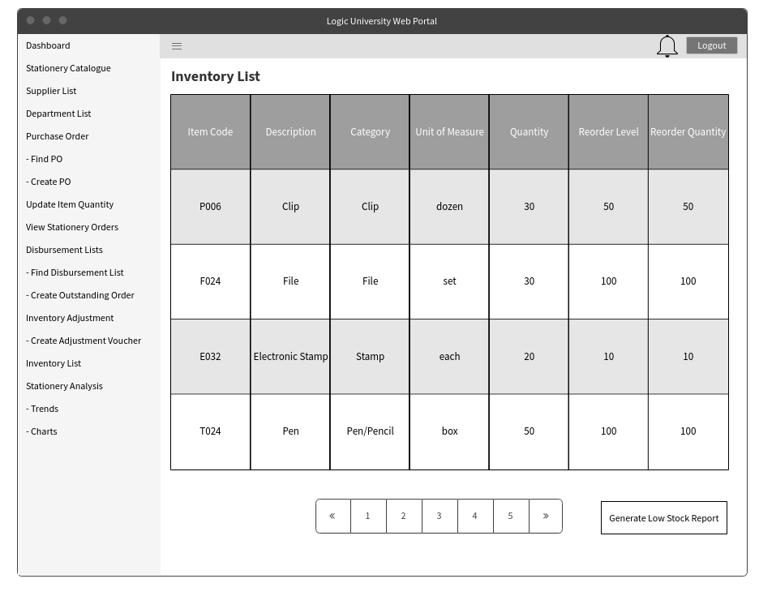
Inventory List
This is the screen that the store clerk would use to view the product catalogue.

Slide 19
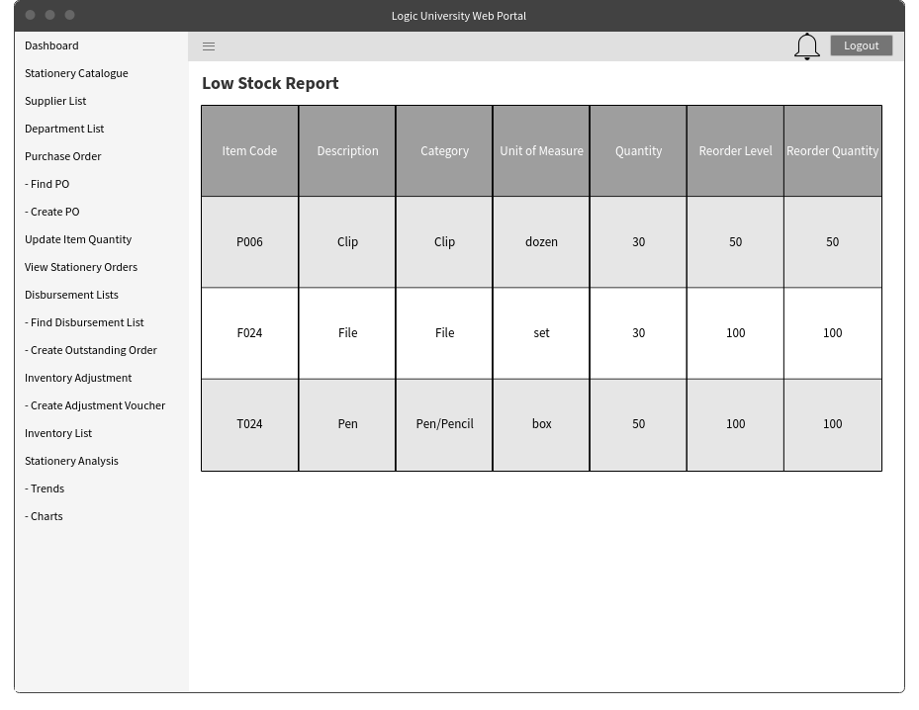
Low Stock Report
This would be the view of all stocks that low in stock.

Slide 20
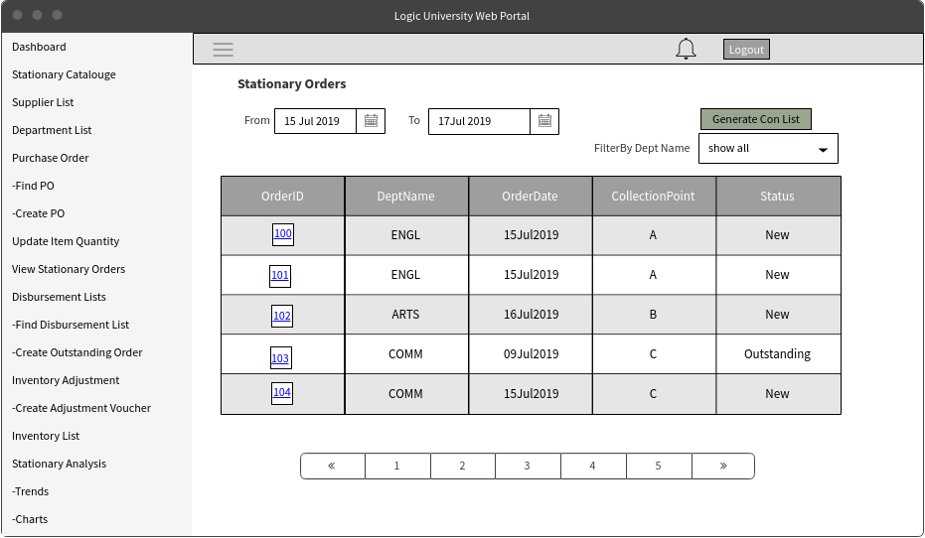
View Stationery Orders
This Screen is to view all the Orders which were placed on that week by filtering with From Date and To Date

Slide 21
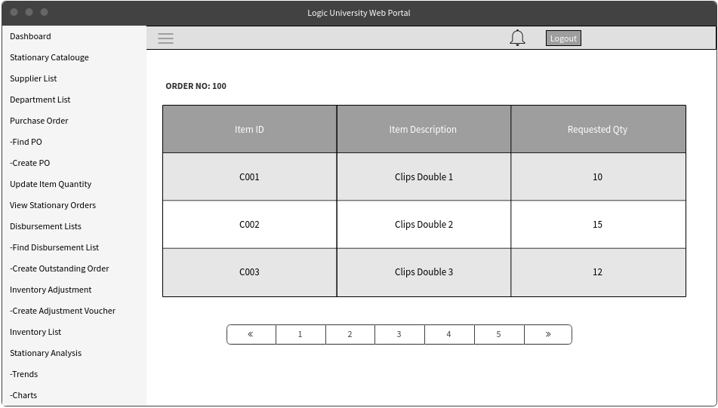
View Stationery Orders
This Screen is to view the details of a particular Order when we click on the Order Link in the previous screen

Slide 22
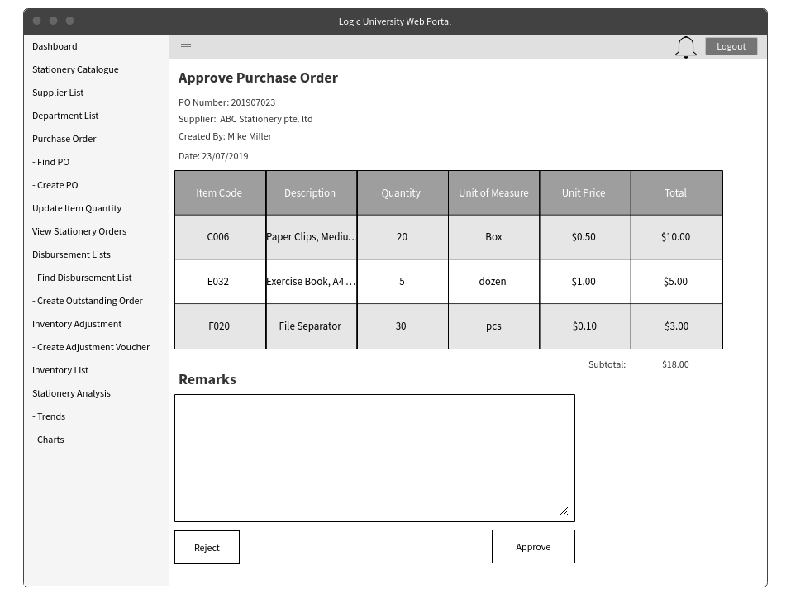
Approve Purchase Order
This is the screen that the store supervisor uses to approve/reject purchase order that the clerk has ordered.

Slide 23
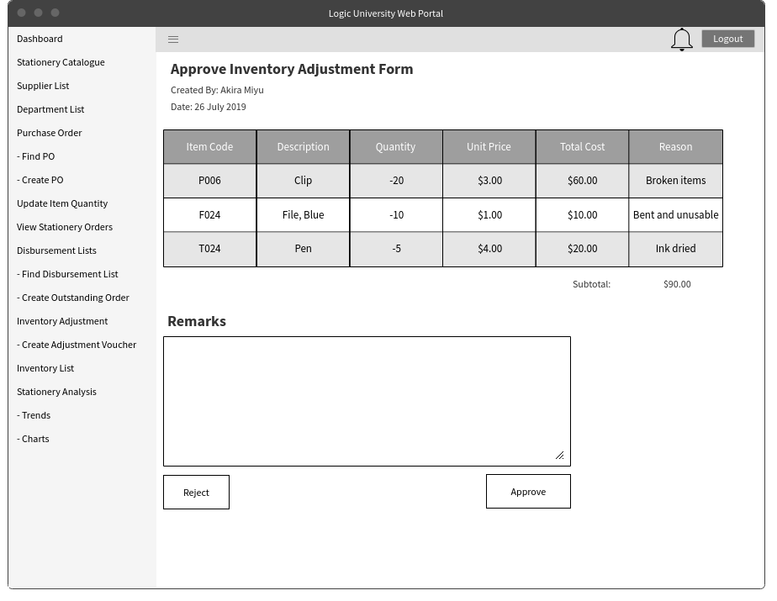
Approve Inventory Adjustment Voucher
This is the screen that the store supervisor and manager uses to approve/reject the adjustment voucher that the store clerk has created.

Slide 24
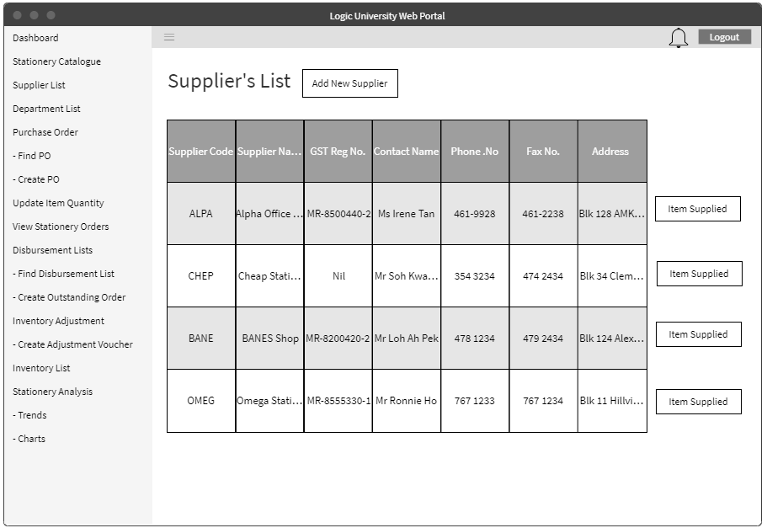
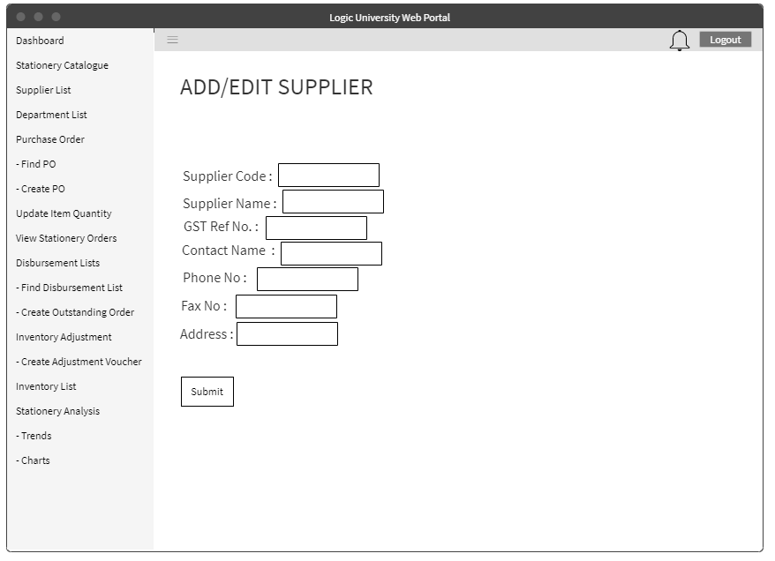
Supplier List for Store Manager
For Store Manager, he/she will be able to modify the supplier’s details.

Slide 25
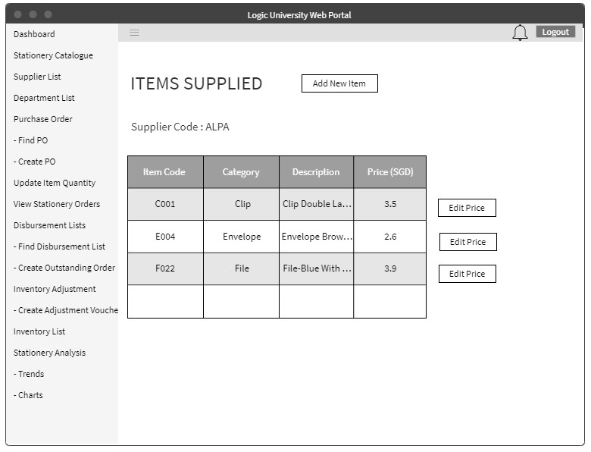
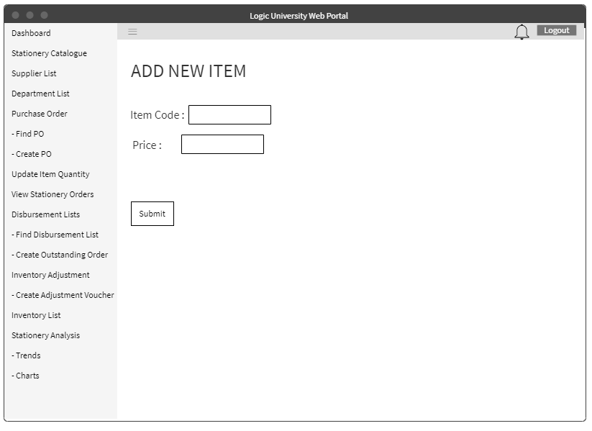
Items Supplied for Store Manager

Slide 26
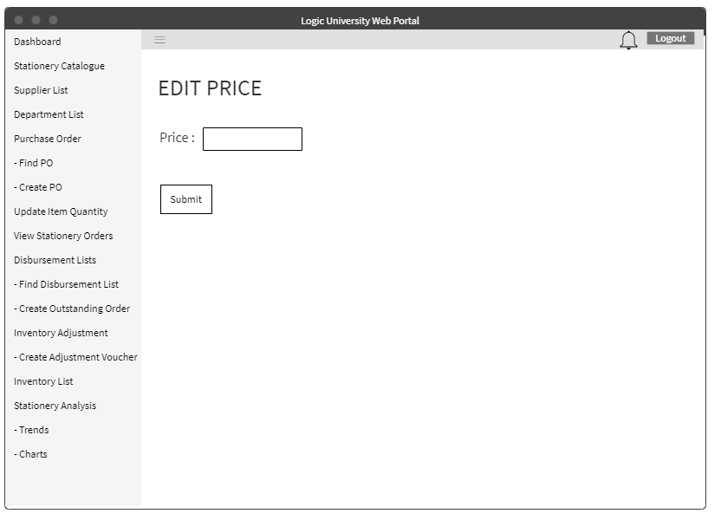
Items Supplied for Store Manager
For Store Manager, he/she will be able to modify(add new item and edit price) of the items supplied by that particular supplier.

